Slide 1
STA 101 R Markdown Tutorial

Slide 2
Submission Guidelines for Lab 2
You should submit your Lab 2 (and beyond) with TWO files:
an R Markdown file (.Rmd)
a file knitted from that (preferably .html, maybe .docx -- your choice).
Look at your .html or .docx file before you submit it, since that’s probably what we’re going focus on when grading.

Slide 3






Is this an R Markdown file?
This, with the little red circle symbol, is R Markdown (.Rmd):
All others ARE NOT R Markdown (here are examples):
If unsure, you, can try to create a code chunk/block with ```{r} (the backquote symbols are typed from the upper left of standard English keyboards, with the tilde: ~ ). other files probably won’t do that. See later slide for text vs. code in R Markdown.

Slide 4
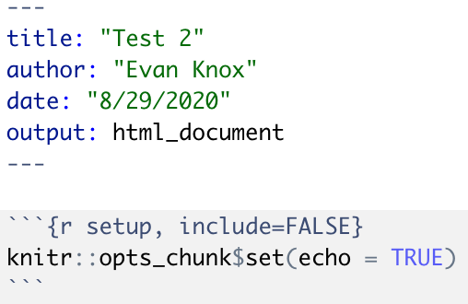
What do I need in my R Markdown document?
When you create an R Markdown document, there’s automatically a lot of words and code in the document
Most everything can (and should) be deleted before you knit or turn in your R Markdown document -- it’s just a tutorial
Basically: keep the info between the --- ‘s, and keep the code section called setup with the knitr:: code in it.
Don’t put comments in either of these sections!
(Yours may not have the author and date in it, although you can add that as pictured!)
Here’s what you need to keep:

Slide 5
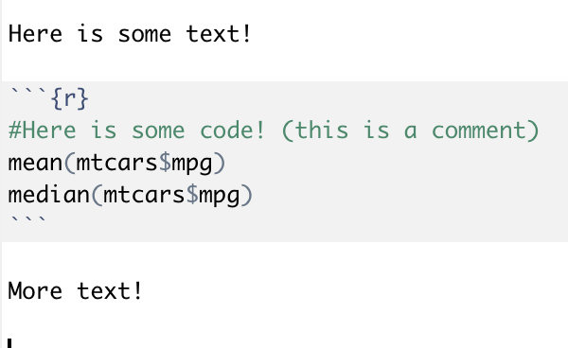
Text vs. Code in R Markdown
R Markdown has two main sections:
Text (like in Microsoft Word or on Google Docs)
It has a white background
Code (which is the R you worked on in Lab 1)
The code has a grey background and we call these sections “chunks” or “blocks”
Note:
In lab 1, you used comments (like the one shown in the code) to give answers; now, you can just type your answers normally.
You don’t need to use # to type normal text (they are used for titles instead).

Slide 6
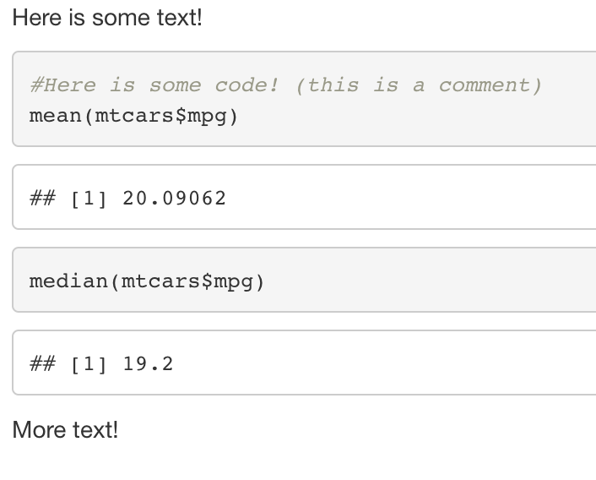
Text & Code when Knitted
This is what that example text & code looks like when you knit it together in HTML. Note that mtcars is just an example dataset here with car information, so we’re just finding mean and median for miles per gallon of cars.

Slide 7
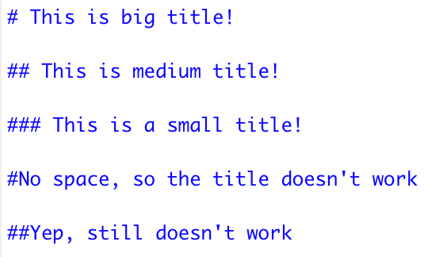
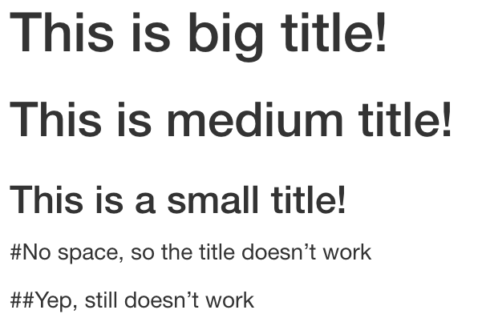
Titles in R Markdown
Using a # in a text section can make a title. The fewer #’s, the bigger the title
(think of it as Chapter, section, subsection for 1, 2, and 3 #’s)
You have to leave a space between the # and the words, otherwise it just puts the # in your text.
Here is what you write in R Markdown:
Here is what it looks like when you knit it:

Slide 8

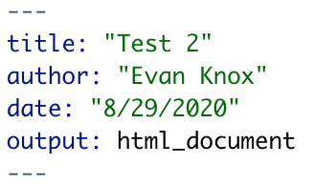
What is knitting, and how does it work?
Knitting is how we take our R Markdown file and convert it to a more convenient way to look at all the text, code, and code output in the same place.
We can knit using the Knit button, which looks like this:
The file will knit to the document listed near the top of your R Markdown document, like an html document here:
In many cases, you’ll try to knit, but it won’t work and you’ll get an error. This is quite common, including for me! It means there’s a code error somewhere, or the R Markdown formatting syntax is messed up.

Slide 9
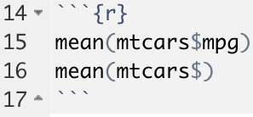
Errors when knitting happen all the time!
When you get the error, it will tell you where the error is, as well as details about that error.
In this example, it’s a big jumble, but the takeaway is “unexpected `)` “, as well as the last part of the code it read being mean(mtcars$) ).
From there, you can go to line 15 and try to see why that “ ) “ was unexpected.
Note: the error is actually on line 16 instead of 15 -- the line isn’t always exact, but it usually gets you in the ballpark.
If you can’t find any obvious error or a change you can do to make it knit, you can usually just copy and paste the first part of the error in Google (from Error to unexpected `)` or so in this example), and you will probably find troubleshooting for that error!

Slide 10
Common Errors
Error | Fix
Could not find function “[Function Name]” | You probably didn’t load the package (/library) that this function is from in your R Markdown document; check to make sure you have library(package name) in your code for each package you’re using.
Error | Fix
Unexpected end of input | This is one of many ways R Markdown might tell you that you forgot to close a set of parentheses ().

Slide 11
I can’t resolve my errors. How do I show them to my TA?
After trying on your own to resolve errors, you may find yourself in need of help or advice from one of the TA’s.
If you can’t make it to office hours, it can help to screenshot/ screen record your code/error to send along with your question to allow them to see what you are seeing.
Here’s a guide on how to ScreenShot/Record on Mac
Here’s a guide on how to ScreenShot/Record on PC
There are many ways to screen shot/record, so don’t feel like you have to use the above.
Alternatively, copy/pasting the code and error message in an email can work as well.

Slide 12
Screen Recording of how to make an R Markdown file for your Labs
Link:
https://drive.google.com/file/d/1vMHT_x5Hr7q_CJGvV46B9wRd1huozslN/view?usp=sharing
(Sorry; it wouldn’t load on here. Also, no sound; it’s just a screen recording.)

